Slide 2
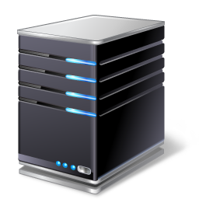


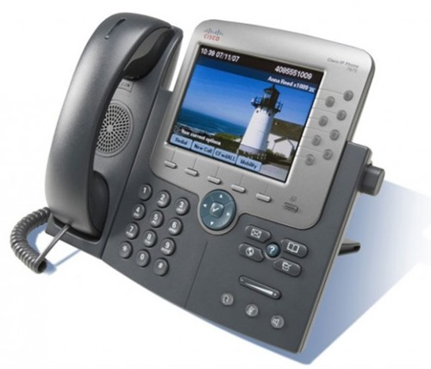

Hot Site
Backup facility
Fully equipped site
Servers and storage
Applications
Network devices
Telephony systems

Slide 3

Cold Site
Backup facility
Not equipped
Office space
Notes:
Fault tolerance is the property that enables a system to continue operating properly in the event of the failure of some of its components

Slide 4

Warm Site
Backup facility
Mostly equipped

Slide 5
Site Considerations
Attributes | Hot site | Warm site | Cold site
Cost | Most expense | Middle ground | Least expensive
Time-to-restore | Minutes - hours | Hours - days | Days - months

Slide 6

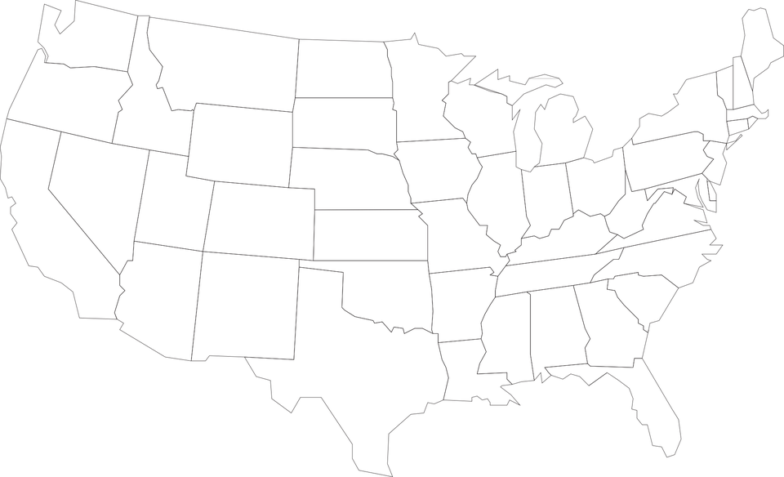


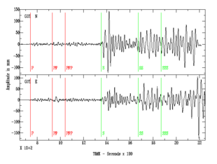
Site Considerations
Location, location, location

